Slide 1
Application of Monte Carlo Search
Jack Malone
C00236428

Slide 2
Project Goals
Implement the monte carlo search algorithm within a board game to allow an AI opponent to be able to play against a person or another AI.
Compare the algorithm against other algorithms and extensions to the algorithm.

Slide 3
Game of Go
each state has approximately 300 posdsible actions compared to chess which has approximately 30 per state.
it is also a lot harder to estimate the value of a certain state which makes it harder to write an evaluation function that could be used with minimax.
this makes the game quite complex to where an algorithm such as minimax would not be able to figure out a good move in a certain position.

Slide 4
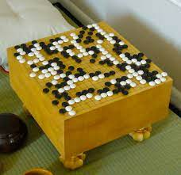

Slide 5
Monte Carlo Tree Search
Useful for games with a high average number of available moves per turn.
can be stopped after a certain time and still give back a good move.
Uses UCB1 to find the best move after searching through a lot of different moves.
Selection
Expansion after not being able to use UCB1 to select anymore
Simulation
Back propagation

Slide 6
Extensions
Early cutoff: Gather data about the game and then use the goal relation and stability to see if an early cutoff should be made.
Unexplored Action Urgency: Makes it possible for less explored actions at the edge of the tree if needed. Uses the UCT value of the already explored actions which is generated in the regular algorithm to create an urgency for a move we haven’t checked to see if we should as well as creating a discount variable to make it less likely to look at a new one once we’ve explored more of the tree.
https://www.aaai.org/ocs/index.php/AAAI/AAAI12/paper/viewFile/4935/5300

Slide 7
MiniMax
Goes between 2 players that are the min andmax where all moves are explored for each player.
depending on whos turn it is then either the move with the highest score or lowest score is used
hueristic is used to approximate the board position
evaluation function is also required to be able to figure out how good a position is for each player.
amount of moves it has to search through can be reduced using alpha beta pruning.

Slide 8
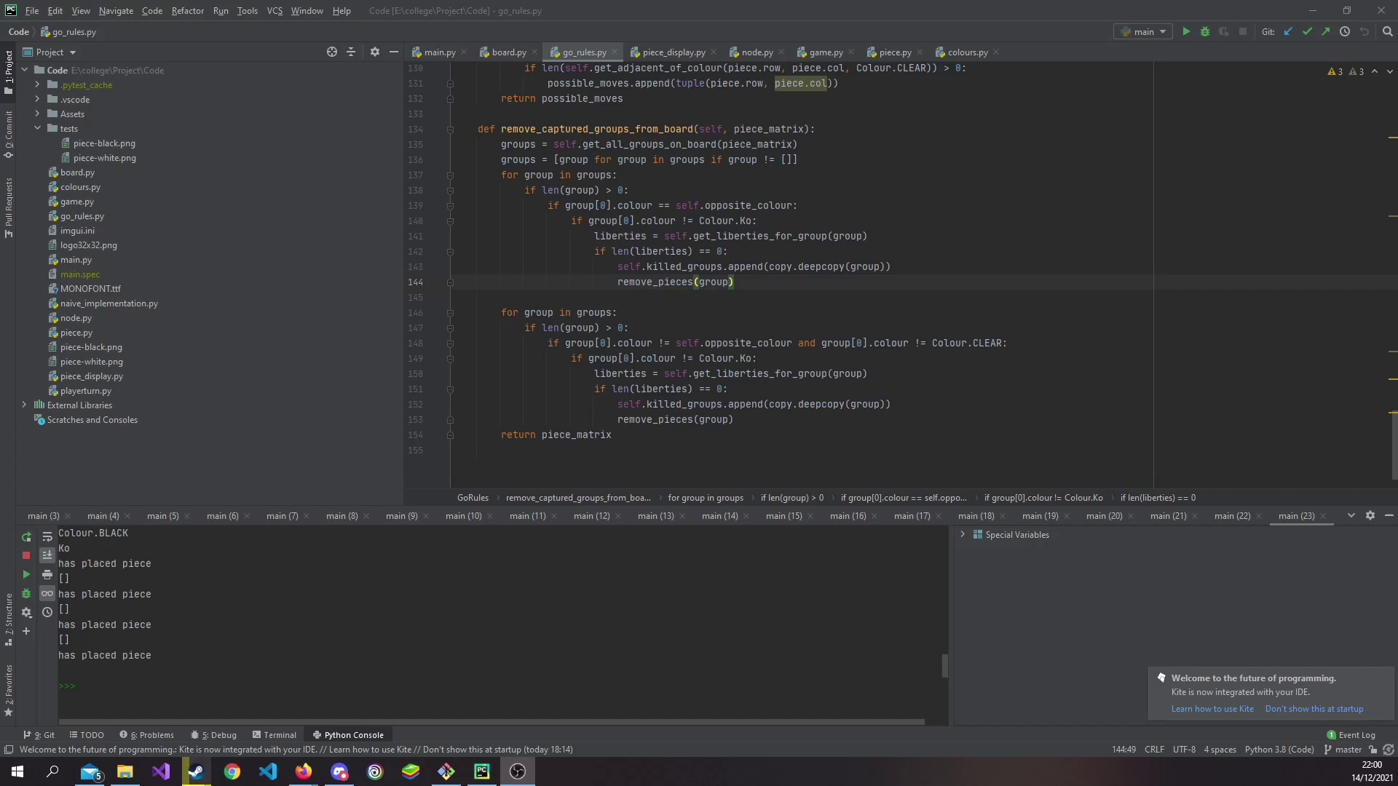
Current Progress

Slide 9
Milestones
Create the basic monte carlo tree search algorithm
Create the minimax algorithm implementation
Create the rest of the different screens in the game to be able to set up the game
Add one or two extensions to the algorithm to see how it improves

